Slide 1
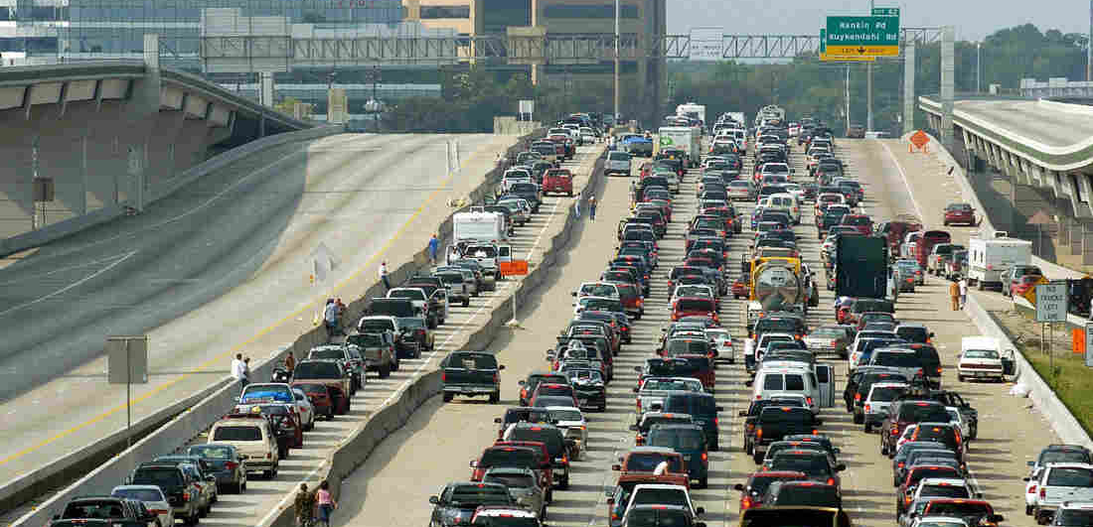
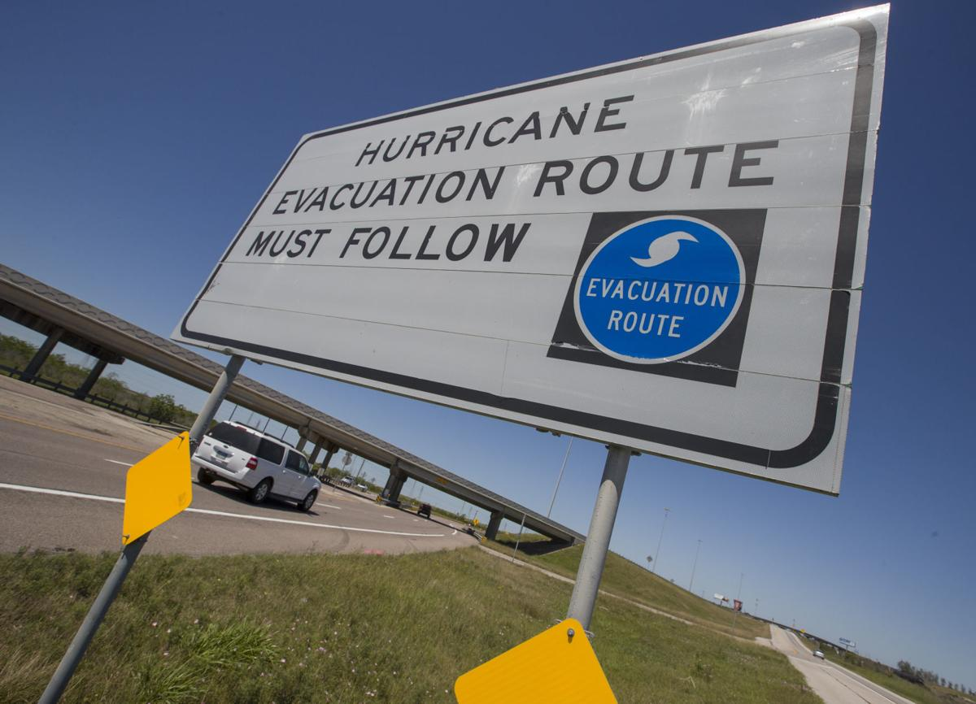
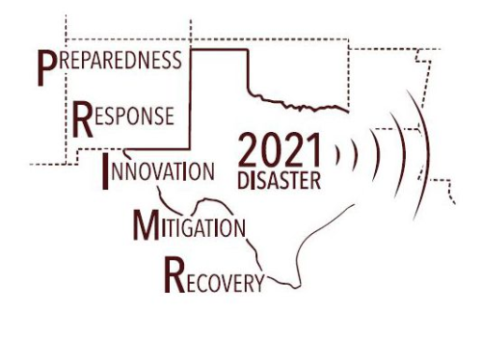

Evacuation Planning for Alternative Fuel Vehicles
Denissa Sari Darmawi Purba
Civil and Environmental Department
University of Illinois Urbana Champaign
Eleftheria Kontou
Civil and Environmental Department
University of Illinois Urbana Champaign
Chrysafis Vogiatzis
Industrial & Enterprise Systems Engineering Department
University of Illinois Urbana Champaign
Notes:
Halo everyone, I am Denissa Purba from the University of Illinois Urbana-Champaign. Today I would like to present my research work about “Evacuation Planning for Alternative Fuel Vehicles”. This works is advised by Professor Eleftheria Kontou and collaborated with Professor Chrysafis Vogiatzis from the University of Illinois Urbana-Champaign

Slide 2
Outline
Motivation
Objective
Evacuation Route Concepts
Numerical Experiment: Sioux Falls Network
Conclusions
Future Work
Notes:
Here are today’s outline

Slide 3
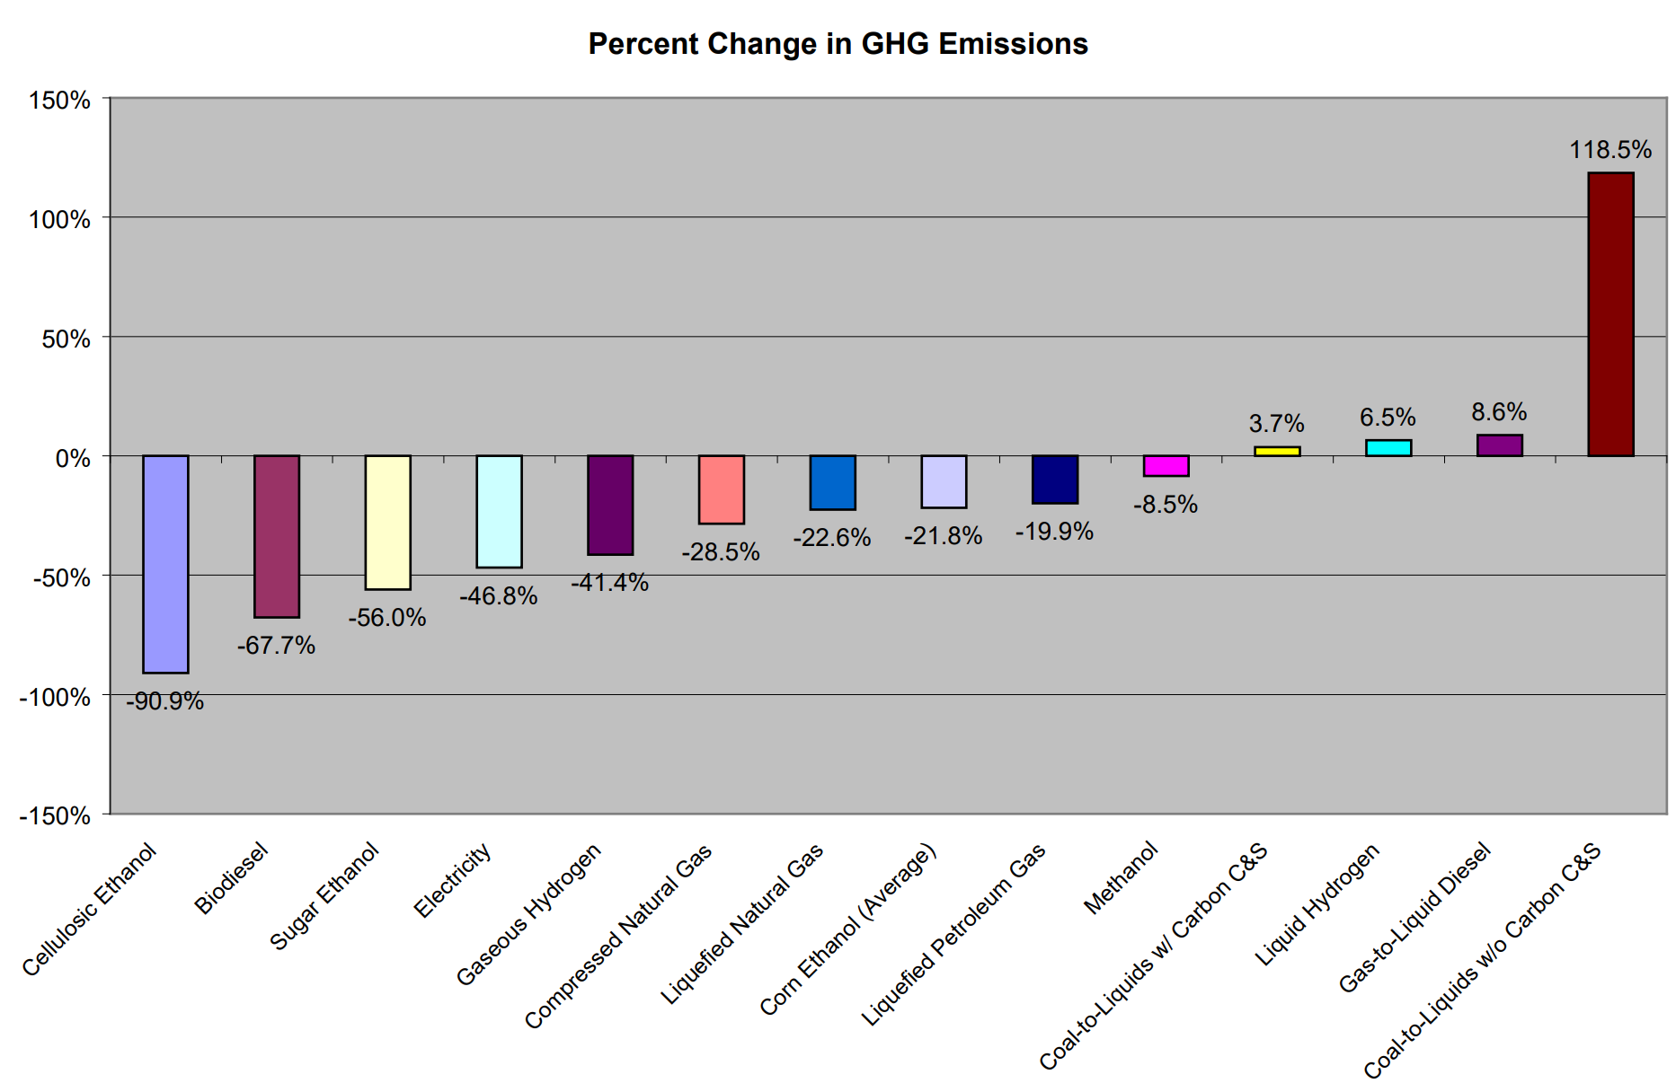
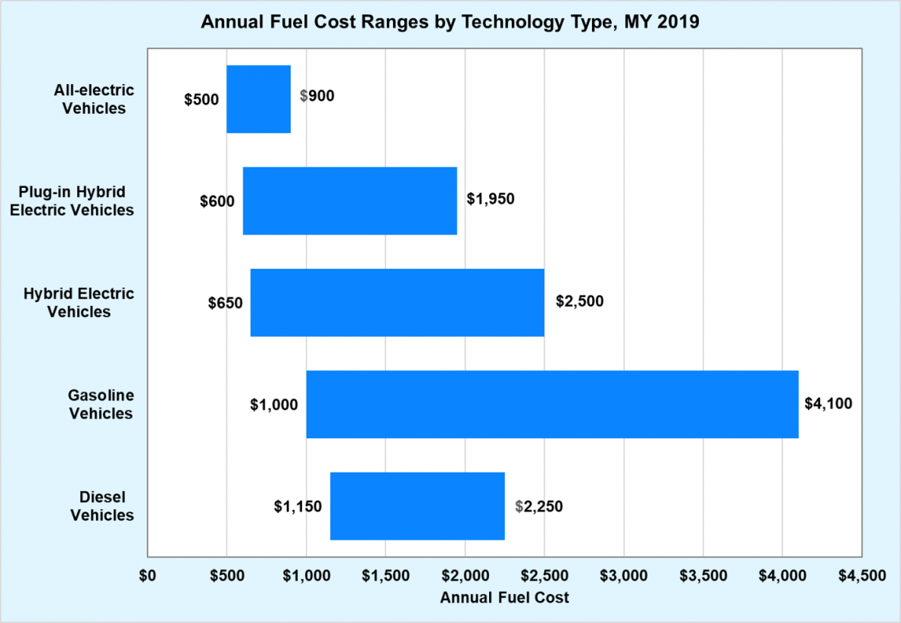
Motivation
Adoption of alternative fuel vehicles contributes to decarbonizing transportation and fighting climate change in the U.S.
EPA Emission Facts EPA420-F-07-035 (2007)
DOE Fuel Facts FOTW #1109 (2019)
Source: U.S. Department of Energy's Office of Energy Efficiency and Renewable Energy, https://afdc.energy.gov/fuels/
Notes:
Nowadays, alternative fuel vehicles becomes very popular and its adoption has increased significant in US market for this past years. Alternative fuel that we can think of in market: biodiesel, ethanol, hydrogen fuel cell, and electric vehicle.
Adoption of alternative fuel vehicles contributes to decarbonizing transportation and fighting climate change in the U.S.
The left figure is obtained form EPA Emission Fact 2007. It shows the percentage change of emissions if we shift to alternative fuels compared to gasoline fuels. It shows that alternative fuel vehicles could reduce emissions significantly compare to gasoline fuel.
And, not only environmental benefit. some of alternative fuel vehicles provide economic benefits.
On the right side, it is obtained from DOE Fuel Facts on 2019. It shows the estimated annual fuel cost for several type of vehicles. We have couple of electric vehicles type compared with gasoline and diesel vehicles. For its estimation, all electric vehicle type have lower annual fuel cost compare to gasoline and diesel vehicle.
These are only small hints why alternative fuels are very promising for our future.

Slide 4
Motivation
Despite alternative fuel vehicles’ advantages, they are the most susceptible during emergency conditions
Adderly et al. (2018) and Feng et al. (2020):
3 main drawbacks of electric vehicles make their drivers vulnerable to evacuation
  Limited driving range and fuel capacity or battery range
Limited access to refueling/charging stations due to sparse infrastructure networks
Long refueling/charging time compared to gasoline vehicles
Notes:
However,
Despite alternative fuel vehicles’ advantages, they are the most susceptible during emergency conditions
Adderly in 2018 and Feng in 2020 described that there are 3 main current drawbacks of electrical fuel vehicles that make driver become vulnerable during evacuation:
1. Limited driving range and fuel capacity
2. Limited access of the charging station
3. Long charging time

Slide 5
Motivation
2 possible vulnerability scenarios during evacuation:
Alt-fuel vehicle evacuation distance exceeds its driving range limit
Vehicle reroutes to refuel/recharge, takes longer to reach shelter due to refueling or charging time
Source: Metaxa et al. (2018)
Notes:
There are 2 possible vulnerability scenarios during evacuation that relate to these drawbacks.
First scenario is when the alternative fuel vehicle evacuation distance exceeds its driving range limit.
Second possible scenario is when the vehicle need to reroute for refueling or recharging, and takes longer to reach shelter due to refueling or charging time

Slide 6
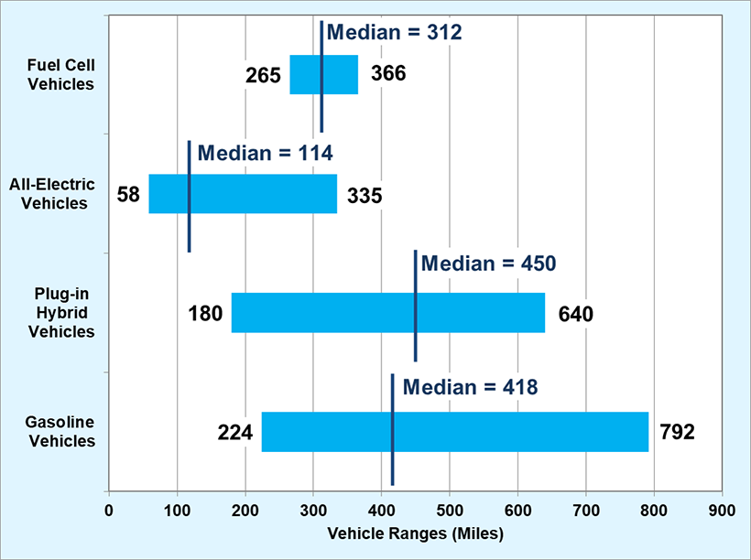
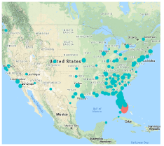
Motivation
DOE Fuel Facts FOTW #1010 (2018)
Driving ranges of EVs are improving since their introduction in the mass market but their range remains limited compared to gasoline vehicles.
Displacement of Hurricane Irma – September 8, 2017
(Mexata et al. 2018)
Illustration: Miami, FL to Jacksonville, FL is about 348 miles
Notes:
Here is the data from DOE Fuel Fact posted on 2018. The left figure shows the driving range for several type of vehicles. We have fuel cell vehicles/hydrogen cars; 2 types of EVs, and gasoline cars. Driving ranges of EVs are improving since their introduction in the mass market but their range remains limited compared to gasoline vehicles.
The limited driving range will become an issue if we have a long-distance evacuation movement.
Here are obtained by Mexata 2018. They used Facebook Disaster Data to capture the movement of Miami resident during Hurricane Irma. The red dot is the position of evacuee on September 5 and the blue dot is their position on September 8. This shows that the movement Is a long-distance movement, not only between city but between state. And for illustration, the distance between Miami, FL to Jacksonville, FL is about 348 miles.

Slide 7
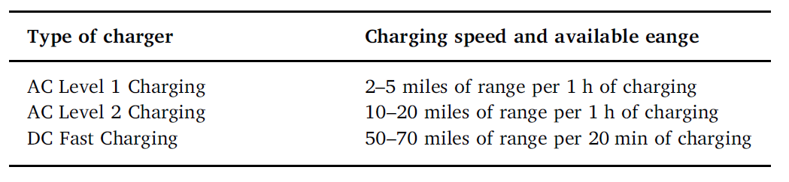
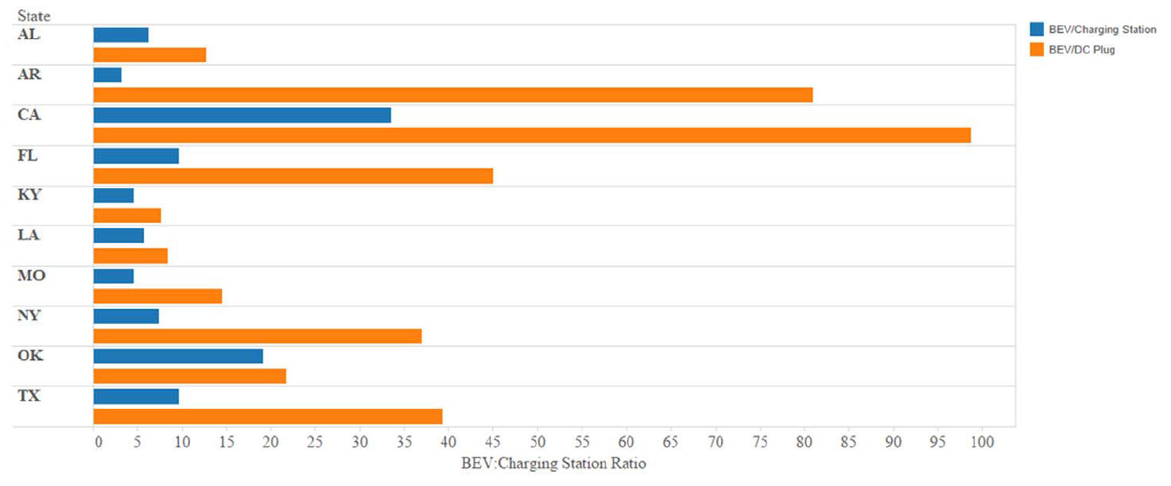
Motivation
DOE Alternative Fueling Station Locator
Refueling stations for alternative fuel vehicles are not as readily available as gasoline stations.
Ratio of the number of BEVs to the charging stations in several states
(Adderly et al. 2018)
10 EVs only have 1 charging station available
40 EVs only have 1 DC Fast Charger available
Notes:
Next, let us see the availability of refueling and recharging stations
The left figure is obtained from DOE. It shows the total refueling/charging stations in nation level. Refueling stations for alternative fuel vehicles are not as readily available as gasoline stations.
Then, Adderly in 2018 studied the ratio of total number of Battery Electric vehicles respect to the available charging station in several states.
There are 3 types of charging that they are consider: AC Level 1, AC Level 2, and DC Fast Charging.
The blue bar shows the ratio of vehicle respect to all charging type and the yellow bar shows the ratio of vehicle respect to DC fast charging
If we focus on Texas:
About 10 electric vehicles only have 1 charging station available
About 40 electric vehicles only have 1 DC Fast Charger available

Slide 8
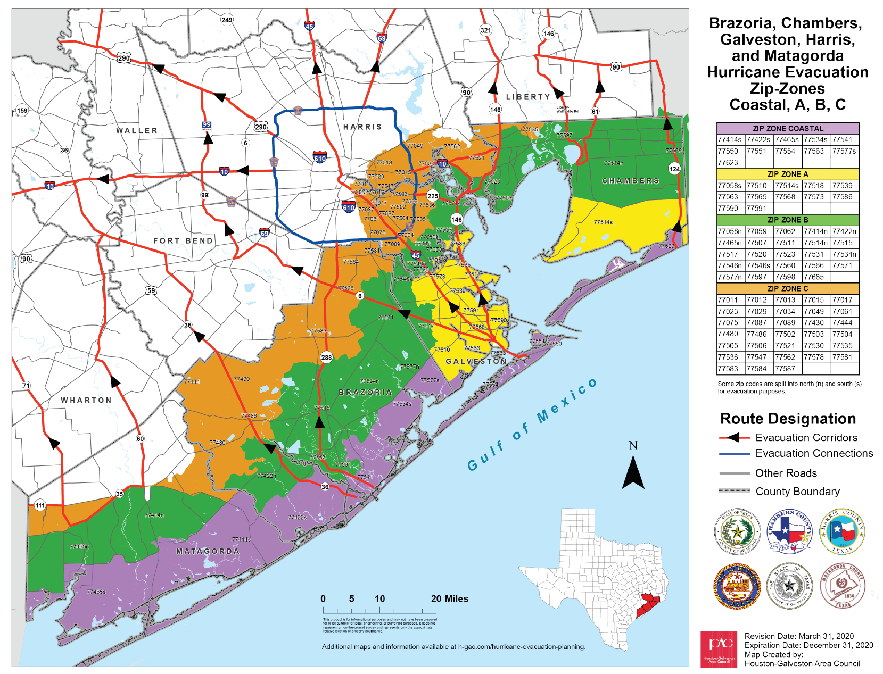
Evacuation Concepts: Old vs New
Who needs to evacuate and who does not?
Where to evacuate to?
When to evacuate?
How to evacuate?
  Which evacuation route/corridor to choose?
  Which mode/vehicle type to use?
Due to the limitations of alternative fuel vehicles, evacuation planning needs to consider the characteristics of the chosen vehicle
  New Question:
  Does the guided evacuation route allow me to refuel my vehicle?
    Will my driving range and the distance comply?
    Is there refuel station close by?
Notes:
Let us go back to the evacuation concepts. Here are the example of Hurricane Evacuation Maps.
There are at least 4 basic questions that we need to consider when we plan evacuation planning
Who needs to evacuate and who does not?
Where to evacuate to?
When to evacuate?
How to evacuate?
Which evacuation route/corridor to choose?
Which mode/vehicle type to use?
Now, Due to the limitations of alternative fuel vehicles, evacuation planning needs to consider the characteristics of the chosen vehicle
We will have new question:
Does the guided evacuation route allow me to refuel my vehicle?
Will my driving range and the distance comply?
Is there refuel station close by?

Slide 9
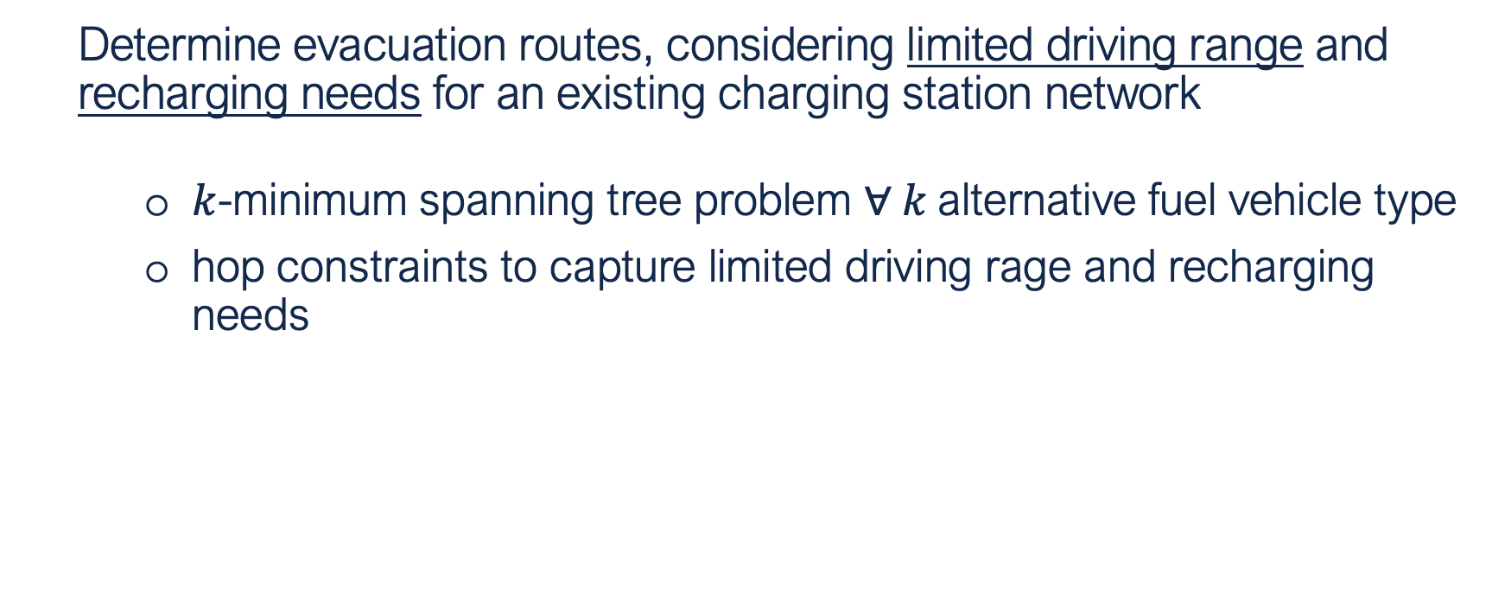
Objective
Determine evacuation routes, considering limited driving range and recharging needs for an existing charging station network
$k$-minimum spanning tree problem $∀ k$alternative fuel vehicle type
hop constraints to capture limited driving rage and recharging needs
Notes:
Therefore, we plan to devise an evacuation route planning.
To Determine evacuation routes, considering limited driving range and recharging needs for an existing charging station network
We approach our goal by developing
$k$-minimum spanning tree problem $for every k$alternative fuel vehicle type
and
hop constraints to capture and illustrate the limited driving rage and recharging needs condition

Slide 10









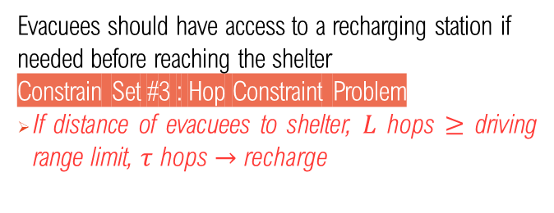

Evacuation Route Concepts
5 Attributes of Proposed Evacuation Routes
Fast
Capture Recharging Needs
Route should enable reaching shelters fast
Objective #1 : Minimize total travel time
Evacuees should have access to a recharging station if needed before reaching the shelter
Constrain Set #3 : Hop Constraint Problem
If distance of evacuees to shelter, $L$ hops $≥$ driving range limit, $τ$ hops $→$ recharge
Safe
The route is safe for evacuees to move, e.g.,
no road blockage/damage and no traffic conflict
Constraint Set #1 : No Traffic Conflict
Links have only one direction
Account for Charging Delays
charging
rate, $r$
distance of evacuees to shelter, $L$ hops
Objective #2 : Minimize total charging delays
charging
delay
$$=$$
$$×$$
Seamless
The route should have at least one clear path to avoid confusion
Constraint Set #2 : Tree Problems
All evacuees are headed to the shelters
Notes:
In this work, we would like to achieve 5 attributes of evacuation routes
1. It must be fast to reach safe destination
2. The route has to be safe for evacuee to move
>Safe can be referred as no road blockage, no road damage, and no traffic conflict
>In this work, we will focus mainly on developing No Traffic Conflict condition
3. Seamless,
>meaning that the routes should have at least one clear path to evacuate to avoid confusion among the drivers
>Which usually be achieved by generating a tree problem for evacuation routes
4. Accommodate the recharging needs
5. Capture delay due to charging time

Slide 11
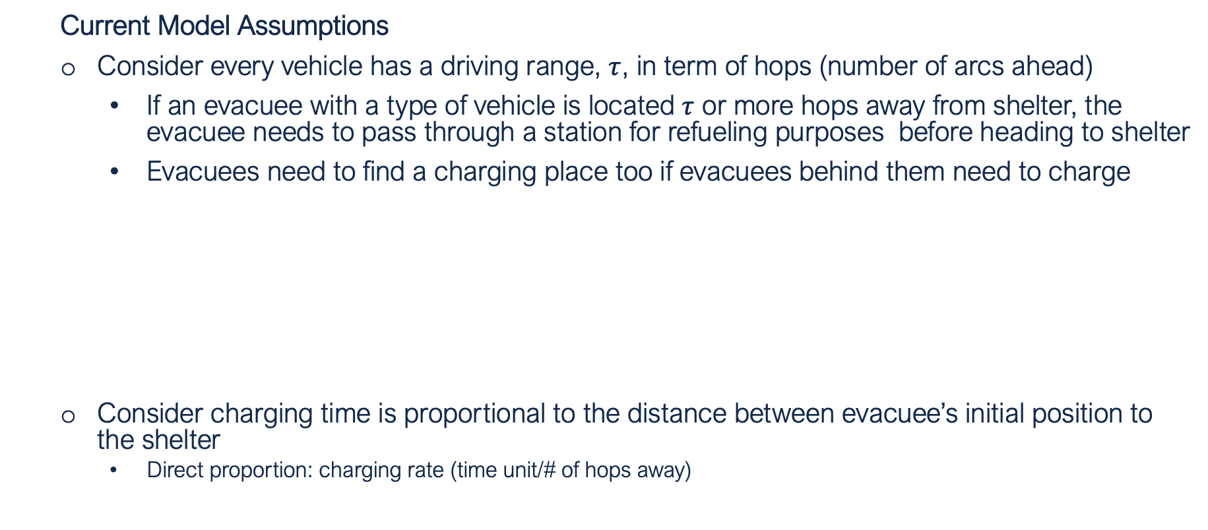



Evacuation Route Concepts
Current Model Assumptions
Consider every vehicle has a driving range, $τ$, in term of hops (number of arcs ahead)
If an evacuee with a type of vehicle is located $τ$ or more hops away from shelter, the evacuee needs to pass through a station for refueling purposes before heading to shelter
Evacuees need to find a charging place too if evacuees behind them need to charge
Consider charging time is proportional to the distance between evacuee’s initial position to the shelter
  Direct proportion: charging rate (time unit/# of hops away)
s
$$τ=2$$
$$l>τ$$
$$l=1<τ$$
i
…
j
m
Notes:
For current model assumptions
We consider every vehicle has has a driving range, $τ$, in term of hops (number of arcs ahead)
Meaning that
If an evacuee with a $certain$ type of vehicle located $τ$ or more hops away from node $s$, the evacuee need to pass through recharging station before evacuating
Evacuees also need to find a charging place too if evacuees behind them need to charge
Here is the illustration to understand the charging decision constraints:
Through this position, we know that node i is located more than tau hops away to the safety, hence node i need to reach charging station m first.
If we see node j, the position is less than tau hop away, initially node j could go to safety node directly
However, in this work, we assume a restricted evacuation route and consider a lumped total evacuee in each node. As evacuee from node i approach node j. We see that evacuee in node i don’t have any opportunity to recharge before reaching node j.
Therefore, we set that node j need to reach charging station m because node i need to recharge
Here is the proposed evacuation route in our model.
Next,
We also consider charging time.
In this work, we assume that charging time has direct proportion to
The distance between evacuees’s initial position to the shelter
By doing this, we only consider evacuee to charge their vehicle as much as they need to reach safety

Slide 12
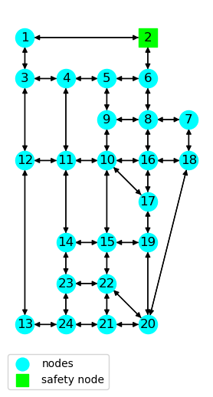
Sioux Falls Network
In this model, we explore the evacuation route planning for Sioux Falls Network under several conditions:
1 shelter exists only at node 2
4 alt-fuel vehicle types:
Vehicle Type 1 : low driving range, sparse refueling network
Vehicle Type 2 : high driving range, sparse refueling network
Vehicle Type 3 : low driving range, dense refueling network
Vehicle Type 4 : high driving range, dense refueling network
Source: Network Properties - https://github.com/bstabler/TransportationNetworks/blob/master/SiouxFalls
Notes:
Next, we did preliminary numerical experiment.
In this model, we explore the evacuation route planning for Sioux Falls Network under several conditions:
There exist only 1 shelter on node 2
4 alt-fuel vehicle types:
which are the combination between low or high driving range limit and dense or sparse refuel network

Slide 13
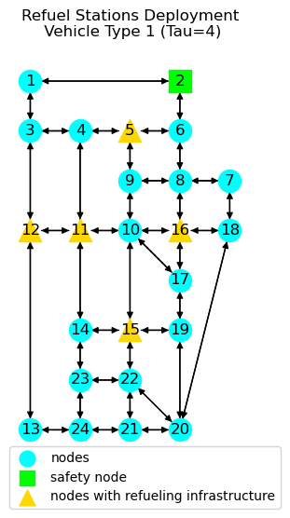
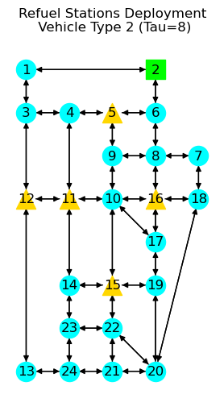
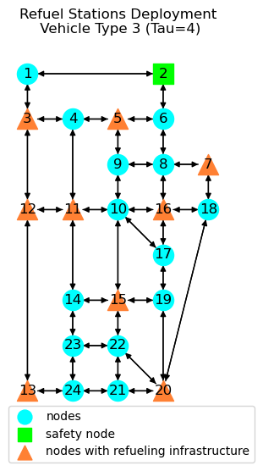
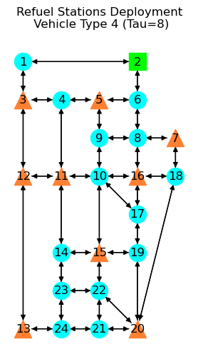
Sioux Falls Network
Notes:
Here are the network topologies for each vehicle types
Vehicle Type 1 : range limit 4 hops, 5 charging station
Vehicle Type 2 : range limit 8 hops, 5 charging station
Vehicle Type 3 : range limit 4 hops, 9 charging station
Vehicle Type 4 : range limit 8 hops, 9 charging station

Slide 14
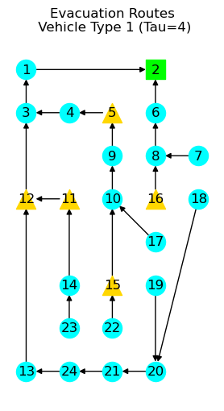
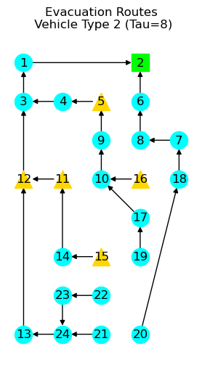
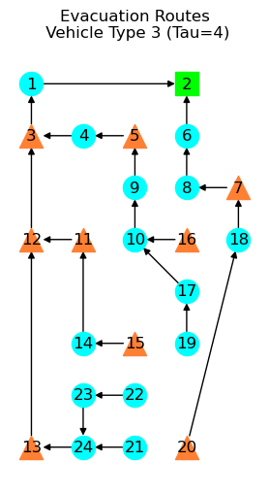

Sioux Falls Network
Total Evacuation Time
65957.454 minutes
Total Charging Time
1350 minutes
Total Evacuation Time
64289.568 minutes
Total Charging Time
120 minutes
Total Evacuation Time
65504.568 minutes
Total Charging Time
1335 minutes
Total Evacuation Time
64289.568 minutes
Total Charging Time
120 minutes
Notes:
Here are the evacuation route result under our proposed model
Findings:
Each evacuation routes are unique for each vehicle type and not feasible for other type
Comparing the vehicle 1 and vehicle 2, as the driving range limit improved, the total evacuation time and total charging time perform better
We also see similar behavior between vehicle 3 and vehicle 4.
Focus on vehicle 3 and vehicle 4, the evacuation route are the same. If we have adequate availability of charging station, then the driving range limit barriers could be anticipated and every vehicle type could access same evacuation route.

Slide 15
Sioux Falls Network
Notes:
NOTE: In this numerical experiment, the study use Gurobi solver. There are several numerical issues due to big-M constraints that need extensive calibration.
We then conduct the sensitivity analysis in term of various range of charging station and range of driving range limit.
Respect to 2 measurements, total travel time and total charging time
Findings
As the driving range limit of alternative fuel vehicle improves, the performance of evacuation routing plan of evacuee in the network improves
As the availability of charging infrastructure of alternative fuel vehicle increases, the performance of evacuation routing plan of evacuee in the network improves

Slide 16
Sioux Falls Network
Notes:
NOTE: In this numerical experiment, the study use Gurobi solver. There are several numerical issues due to big-M constraints that need extensive calibration.
We then conduct again the sensitivity analysis to evaluate for 2 controlled evacuee position, Node 8 and Node 20.
Respect to the evacuation length (hop)
Findings
As the driving range limit improves and the availability of charging infrastructure increases, each vehicle is able to choose shorter distance without need to reroute for charging or refueling

Slide 17
Conclusions
The characteristics of the vehicle (driving range, fuel capacity, and refuel station availability) are important in determining the evacuation route
Each evacuation route for each vehicle type is unique and not feasible for other types
Even though there may exist shorter routes to safety, each alternative fuel vehicle type will detour to recharge before reaching safety
Notes:
To conclude,
Form our model formulation, we observed that
The characteristics of the vehicle driving range, fuel capacity, and refuel station availability) are important in determining the evacuation route
Each evacuation route for each vehicle type is unique and not feasible for other types
Even though there may exist shorter routes to safety, each alternative fuel vehicle type may detour to recharge before reaching safety

Slide 18
Future Works
Exercise complete sensitivity analysis on benchmark Sioux Falls Network
Model accurately the charging process and driving range limit variation with actual distance length
Consider if the evacuees can choose their own route
Plan evacuation routes for real transportation networks
Model the charging station deployment policy for emergency
Notes:
And here are the future works that we would like to extend for our paper.
We would like to improve the model to be more realistic and model the charging station deployment policy.

Slide 19
Thank You
Denissa Sari Darmawi Purba
Civil and Environmental Department
University of Illinois Urbana Champaign
Email: dpurba2@illinois.edu
Phone: (217) 550-2240
Notes:
That is all about my presentation.
Thank you.

